Slide 1
ICS 141 – Programming With Objects
Lecture 6 – Robert Jahn
Based on the slides of Dr. Daniel Liang

Slide 2
Schedule
Announcements/Reminders 6:00 – 6:05
Composition/Aggregation 6:35 – 6:45
Arrays of Objects 6:45 – 6:55
Inheritance 7:10 – 7:45
Assignment #5 7:55 – 8:00

Slide 3

Object Composition
Composition is actually a special case of the aggregation relationship. Aggregation models has-a relationships and represents an ownership relationship between two objects. The owner object is called an aggregating object and its class an aggregating class. The subject object is called an aggregated object and its class an aggregated class.

Slide 4
Class Representation
An aggregation relationship is usually represented as a data field in the aggregating class. For example, the relationship in Figure 10.6 can be represented as follows:

Slide 5
Aggregation or Composition
Since aggregation and composition relationships are represented using classes in similar ways, many texts don’t differentiate them and call both compositions.

Slide 6
Aggregation Between Same Class
Aggregation may exist between objects of the same class. For example, a person may have a supervisor.
public class Person {
// The type for the data is the class itself
private Person supervisor;
...
}

Slide 7
Aggregation Between Same Class
What happens if a person has several supervisors?

Slide 8
Arrays of Objects

Slide 9
Array of Objects
Circle[] circleArray = new Circle[10];
An array of objects is actually an array of reference variables. So invoking circleArray[1].getArea() involves two levels of referencing as shown in the next figure. circleArray references to the entire array. circleArray[1] references to a Circle object.

Slide 10
Array of Objects, cont.
Circle[] circleArray = new Circle[10];

Slide 11
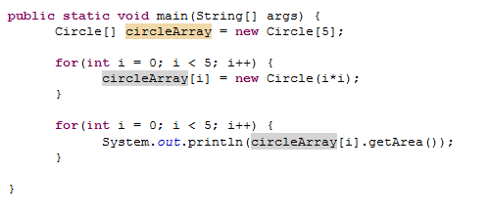
Array of Objects, cont.
Summarizing the areas of the circles

Slide 12
Inheritance, Polymorphism, and dynamic binding

Slide 13
Motivations
Say we want to define classes to model various shapes, such as circles, triangles, rectangles, and squares. Many of these shapes share similar features. We can imagine that all of them would have data fields responsible for storing area, perimeter, and some other features. Further, they would all need methods to calculate perimeter and area.
So, if we define these classes normally, we are going to notice much of the same code being re-used time and again. How do we avoid this redundant coding? As we shall see, inheritance is a Java’s solution to this issue.

Slide 14
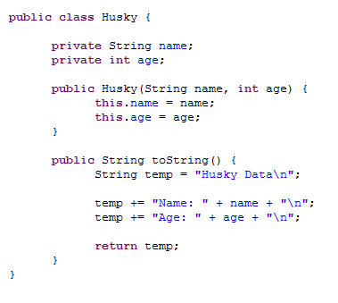
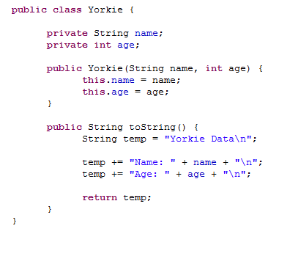
As an example

Slide 15
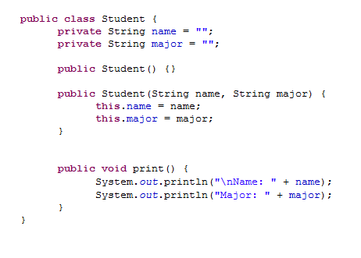
Board Example

Slide 16
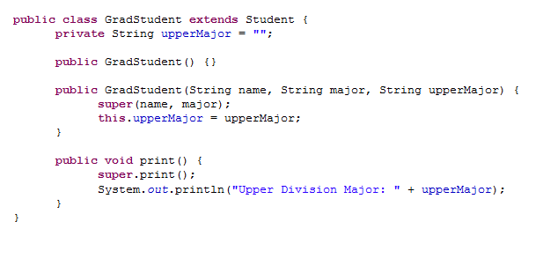
Board Example

Slide 17
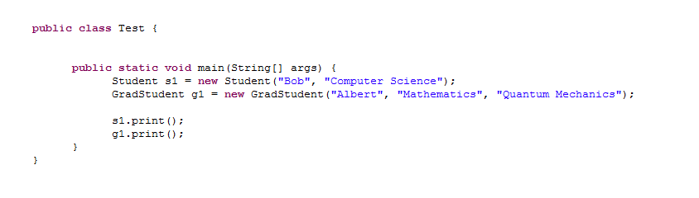
Board Example

Slide 18
UML Class diagrams modeling inheritance
This is the example the book uses. We’ll be going forward with a slightly altered example.

Slide 19
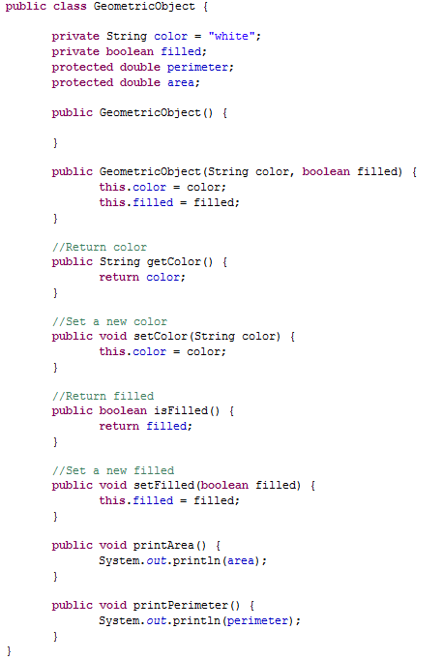

Slide 20
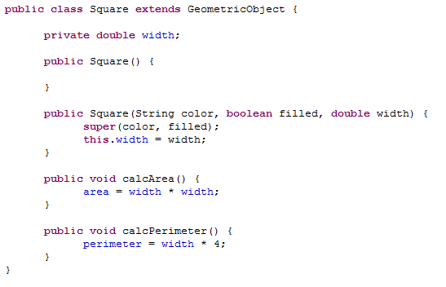
Square Class

Slide 21
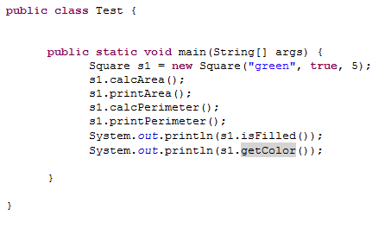
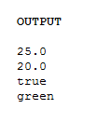
Testing our inheritance

Slide 22
Terminology
When we use inheritance, the class from which we inherit is called the superclass.
GeometricObject class
The class that does the inheriting is called the subclass.
Square class
We use the extends keyword to indicate that we want to inherit from another class.
We use the super keyword to reference the superclass. It is useful for when we want to call the superclass constructor.

Slide 23
What is inherited?
Any accessible data fields.
public, default, and protected data fields are all inherited.
private data fields are not inherited. Instead, the super class would provide public getters/setters in order to access these fields.
Any accessible methods.
public, default, and protected methods are all inherited.
We do not directly inherit the constructor of our superclass.
Instead, these superclass constructors are either implicitly or explicitly invoked.

Slide 24
Constructors
A constructor is used to construct an instance of a class. Unlike data fields and methods, a superclass's constructors are not inherited in the subclass. They can only be invoked from the subclasses' constructors, using the keyword super. If the keyword super is not explicitly used, the superclass's no-arg constructor is automatically invoked.

Slide 25
Superclass’s Constructor Is Always Invoked
A constructor may invoke an overloaded constructor or its superclass’s constructor. If none of them is invoked explicitly, the compiler puts super() as the first statement in the constructor. For example,

Slide 26
CAUTION
You must use the keyword super to call the superclass constructor. Invoking a superclass constructor’s name in a subclass causes a syntax error. Java requires that the statement that uses the keyword super appear first in the constructor.

Slide 27
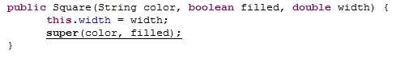
CAUTION
This will result in the compiler error, “Constructor call must be the first statement in the constructor.”

Slide 28
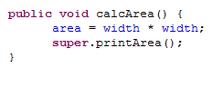
Calling superclass methods
We can also use the super keyword to call the methods of the superclass. This is useful if we have overridden a method in the subclass and we need to distinguish which method we’d like to call.
Remember calcArea() within the Square class? Consider this new version of calcArea(), which now prints the area after calculating it.
Here, we use the super keyword to indicate that we want to call the printArea() method from the superclass.

Slide 29
The object class and its toString() method
Every class in Java is a descendent of the Object class. The Object class is essentially at the top, and all other classes, at some point, inherit from this class directly or indirectly.
You may think that if we do not inherit from any class, then we cannot possibly inherit from the Object class. However, this is not the case. The class will automatically extend the Object class if no inheritance is specified.
The toString() method actually originates from the Object class.

